Slide 1
Climate Crisis:
Solutions and Possibilities
Mark D. Levine
Senior Advisor
Lawrence Berkeley National Laboratory
For Berkeley Society of Friends
September 17, 2021

Slide 2
Topics
Selected News: July and August 2021
Some Basic Information
Statistical Studies of Impacts
Prognosis for Climate Stabilization
  – Daunting Challenge
  – Some Reasons for Optimism
What is to be Done?
  – Individuals
  – U.S. Policies
  – Global Issues: Developing Countries

Slide 3
1 Selected News:
July and August 2021

Slide 4
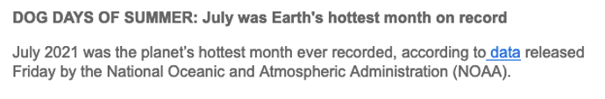

Slide 5
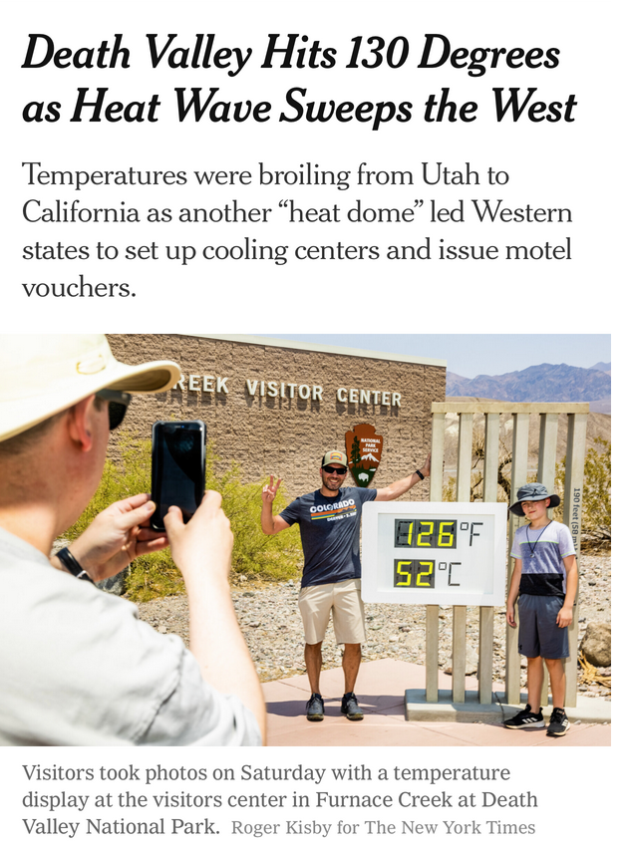

Slide 6
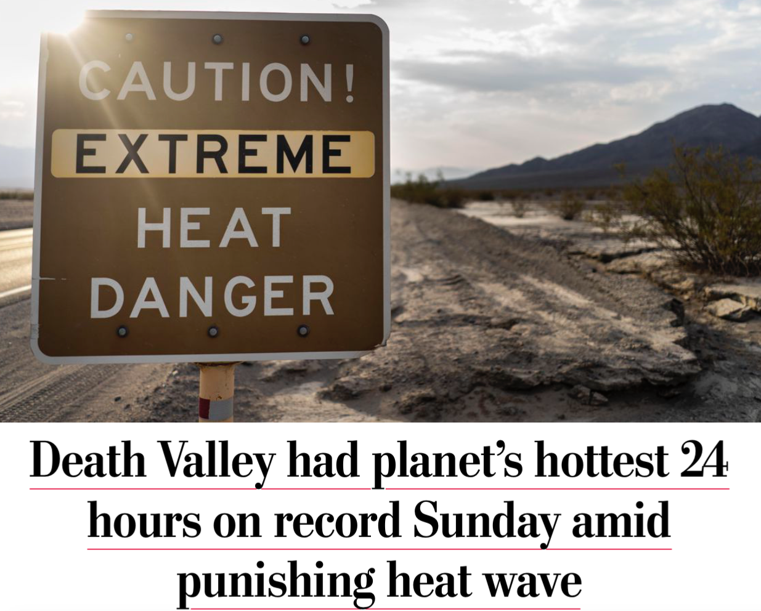

Slide 7
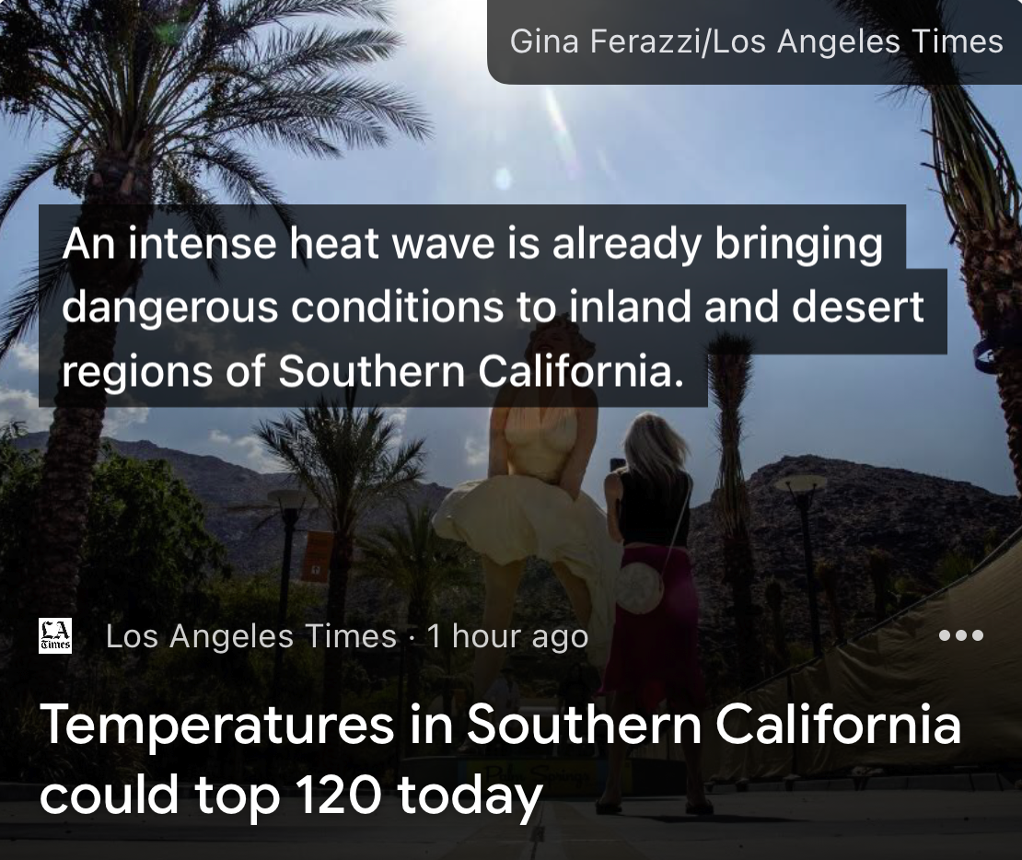

Slide 8
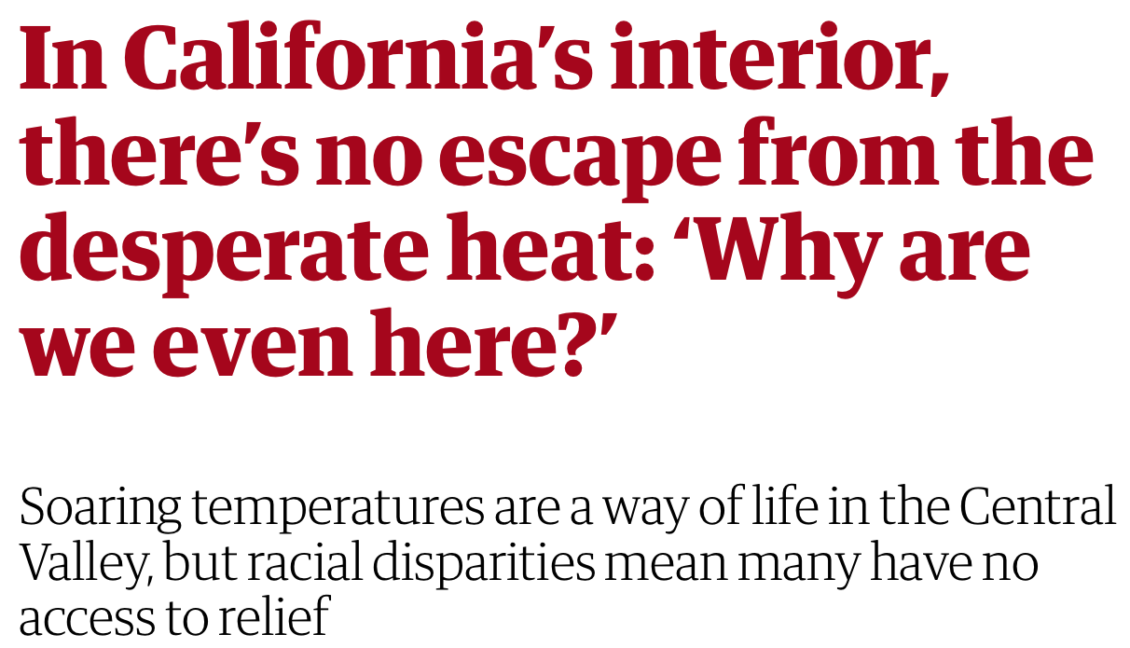

Slide 9
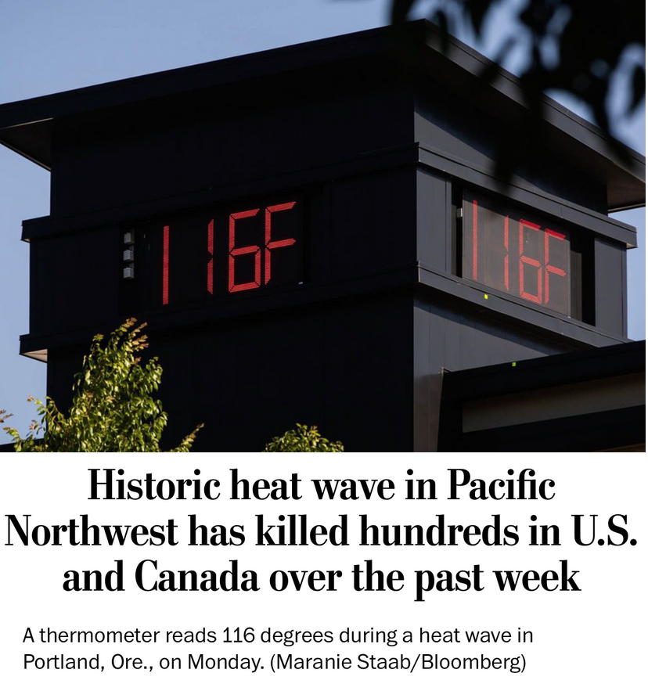

Slide 10
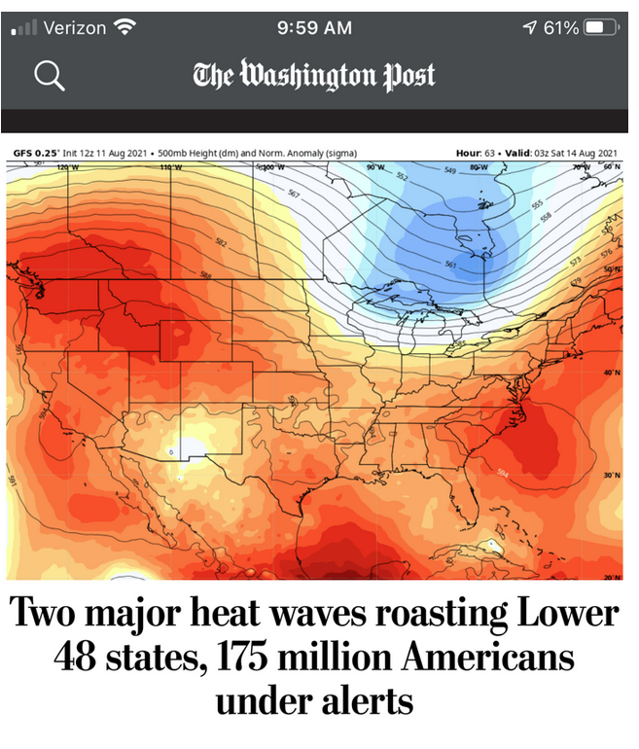

Slide 11
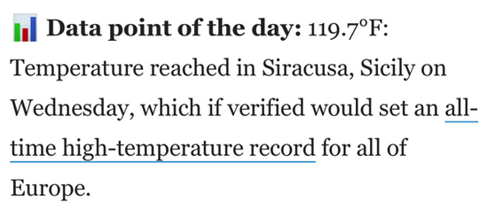

Slide 12
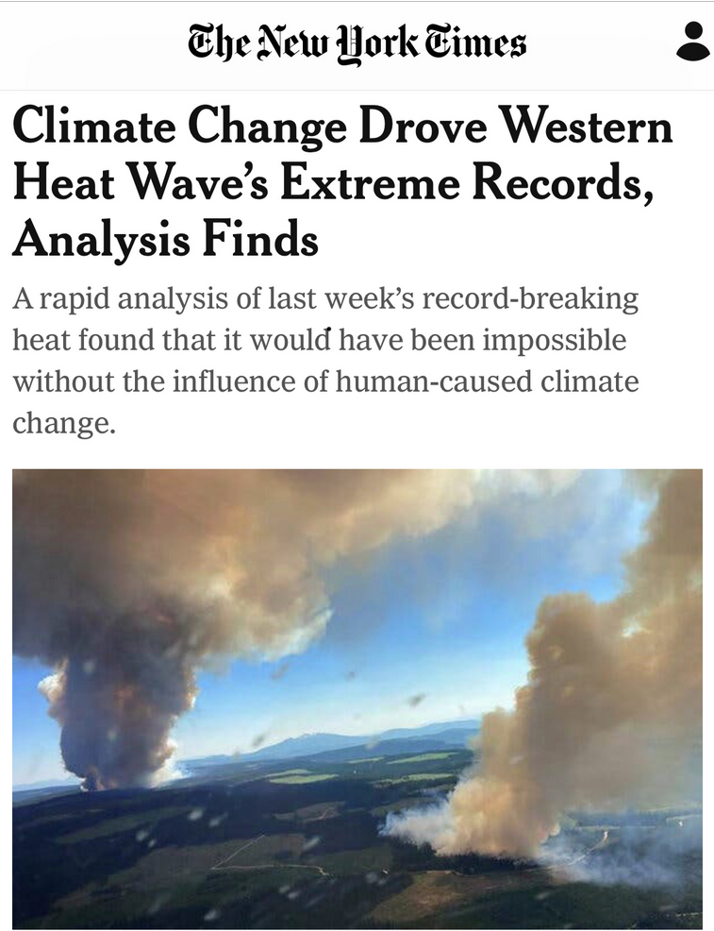

Slide 13
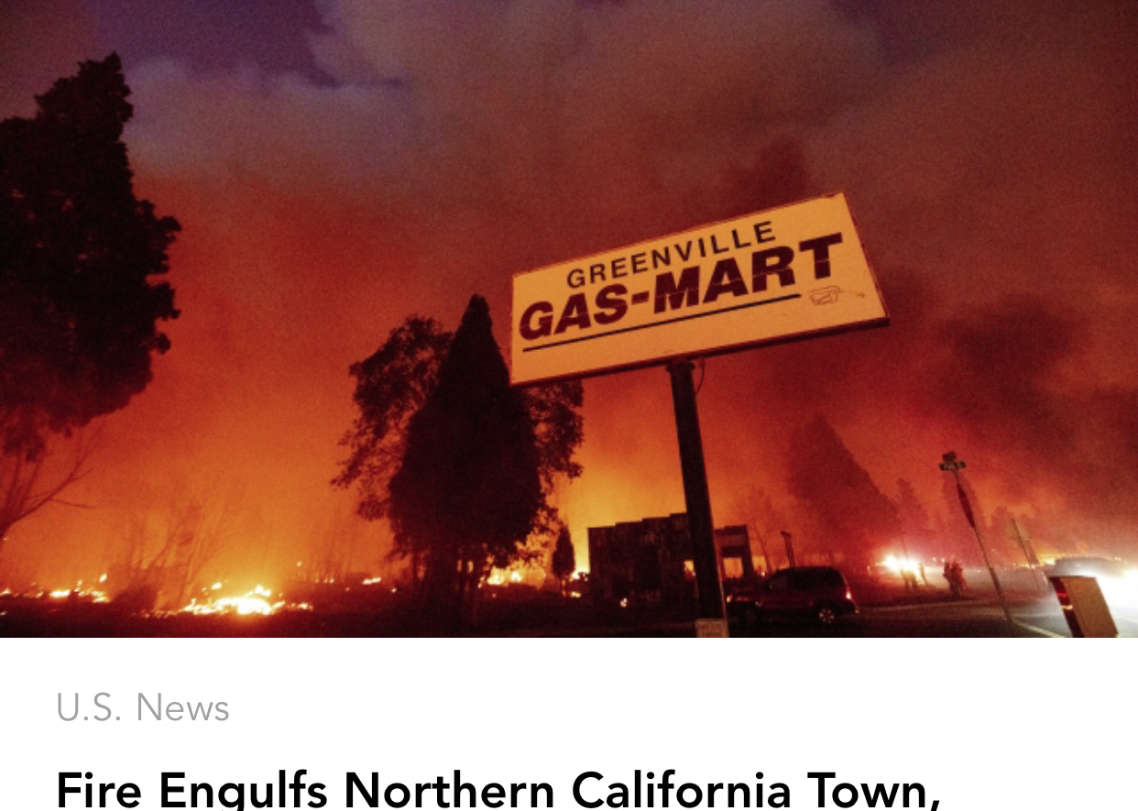

Slide 14
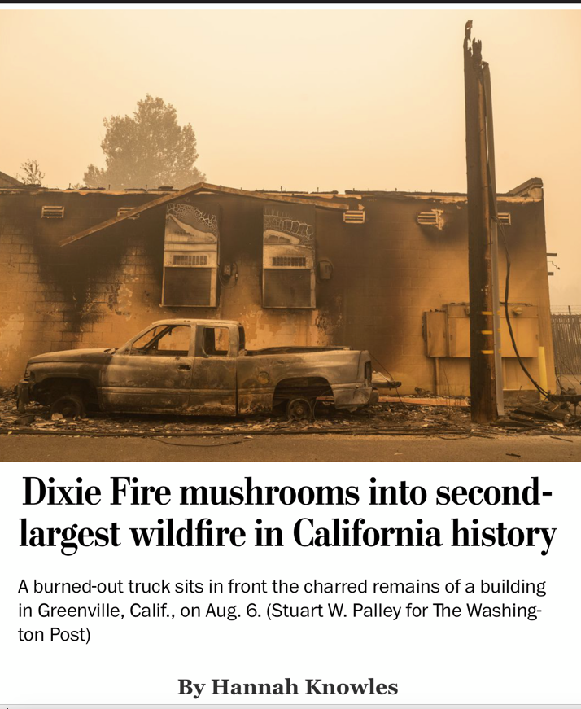

Slide 15
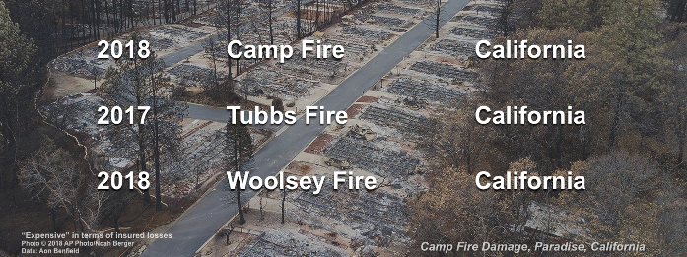
The three most expensive wildfires in world history have happened in the last four years
(now four most expensive in five years)

Slide 16
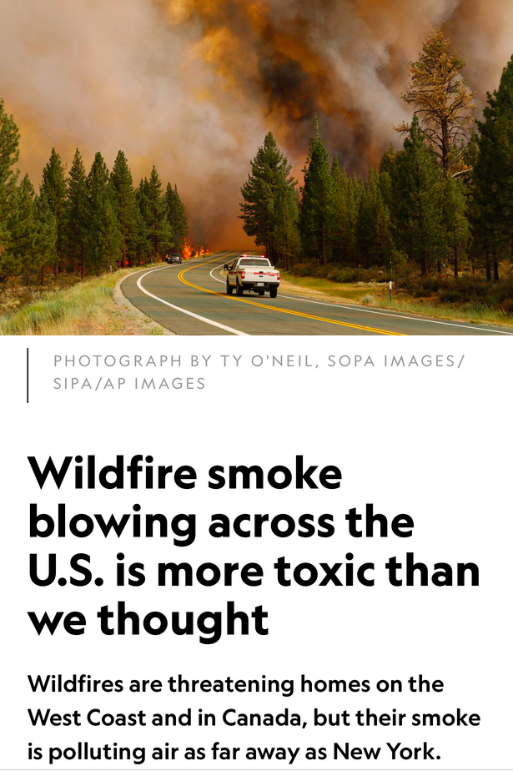

Slide 17


Slide 18
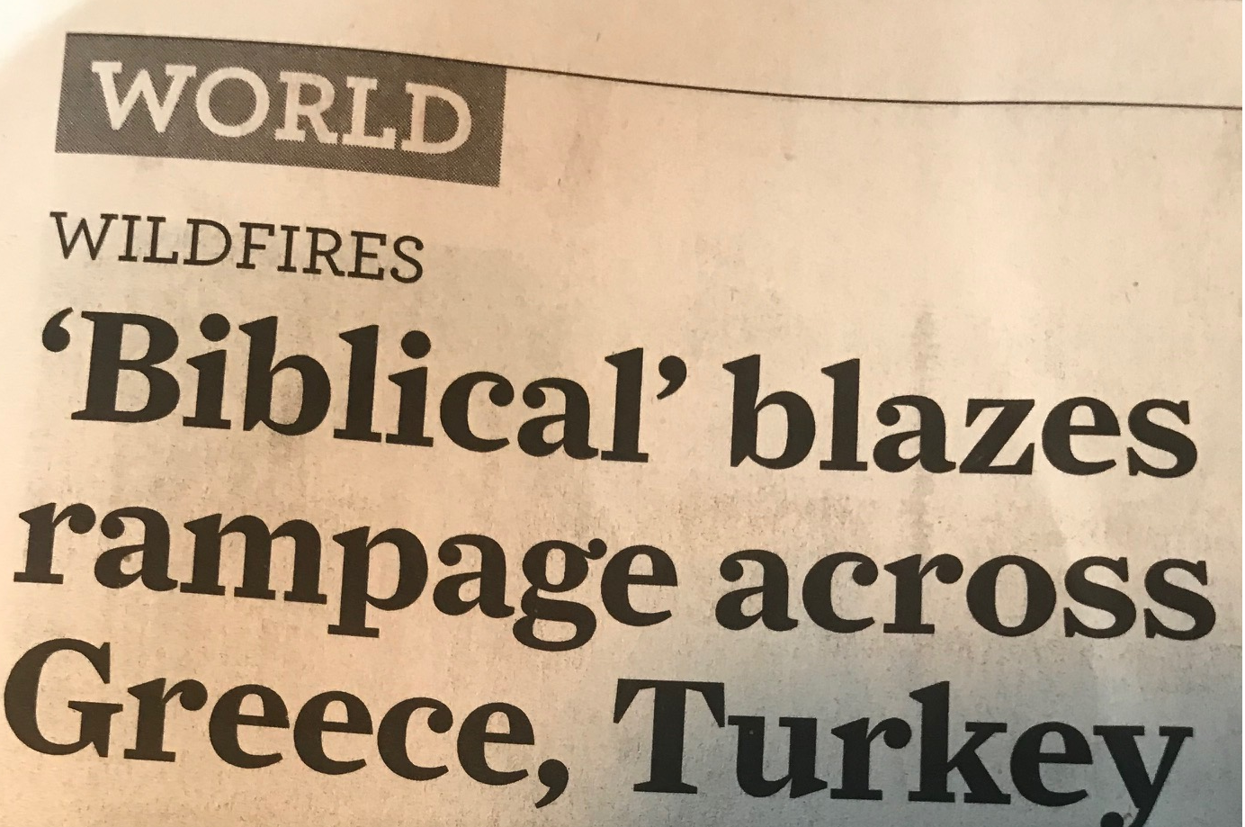

Slide 19
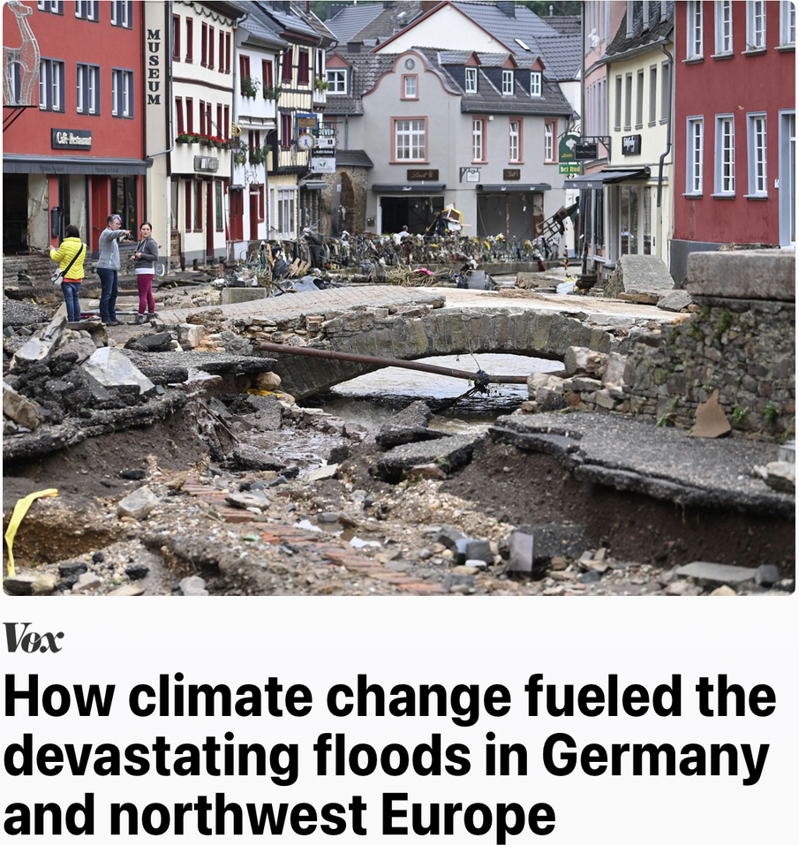

Slide 20
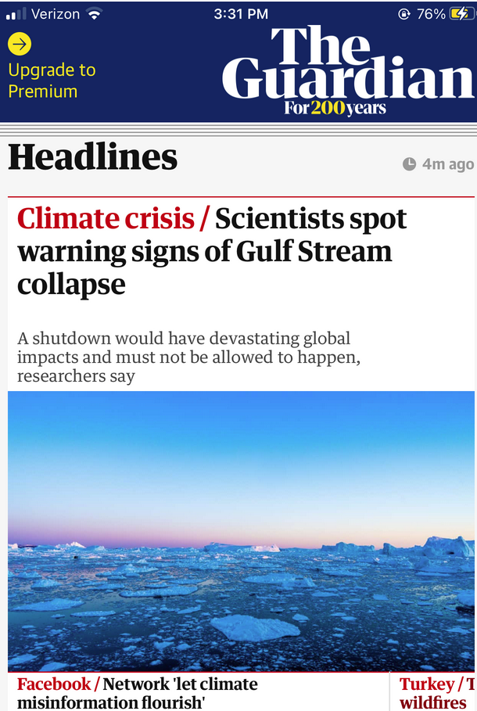

Slide 21
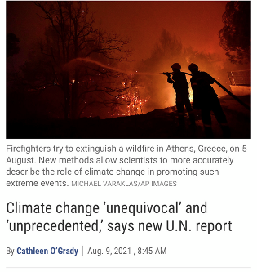

Slide 22
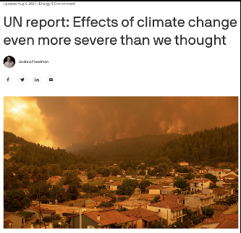

Slide 23
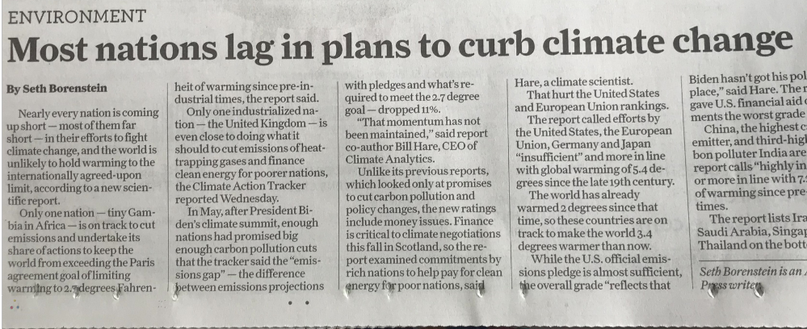

Slide 24
2 Some Basic
Information

Slide 25
IMPACTS beyond high temperatures and forest fires
– Ocean acidification
– Higher ocean temperatures
– Arctic sea ice and glaciers
– Sea rise
– Hurricanes, torrential rainfall and floods
– Droughts
– Food supply
– Water supply
– Climate refugees
– Diseases

Slide 26
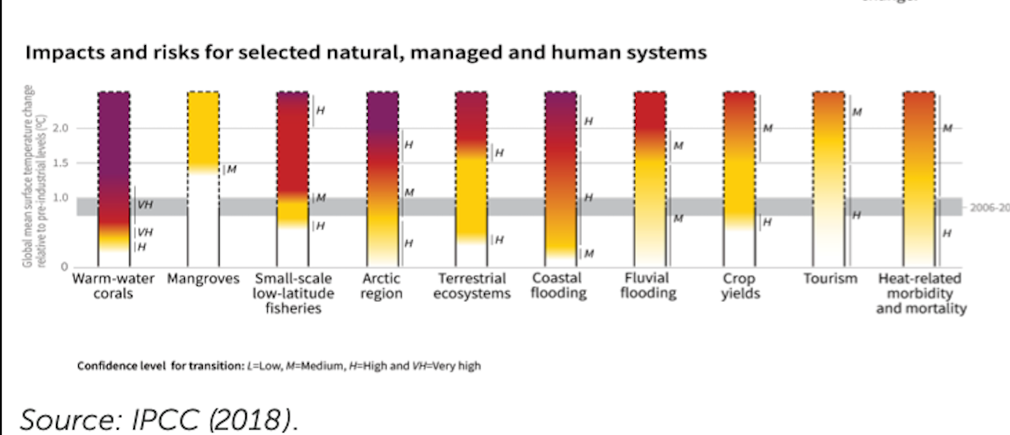

Slide 27
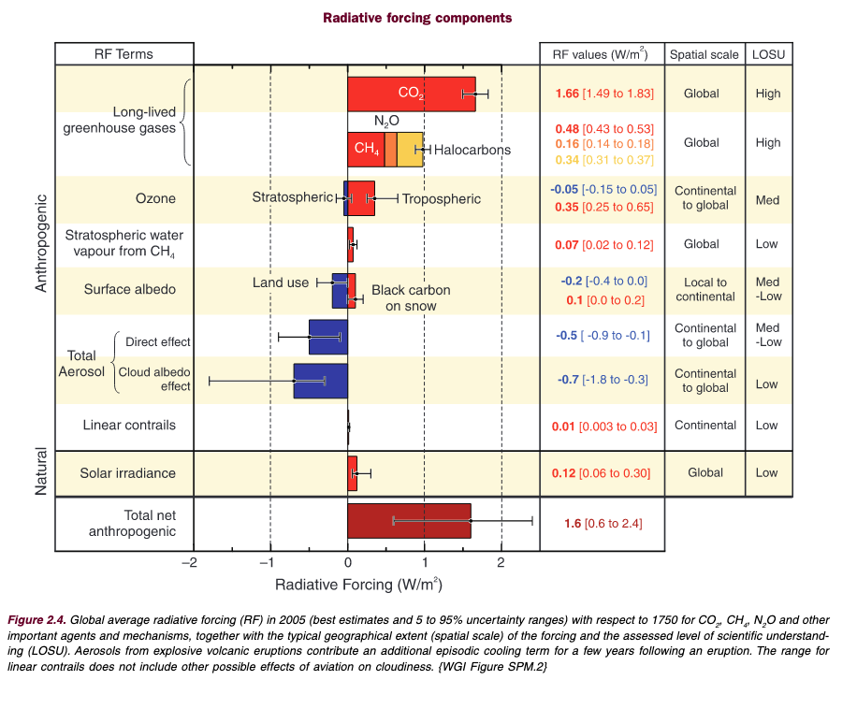
Global Warming Potential of Greenhouse Gas Emissions

Slide 28
Temperature and CO₂ Concentration
Increase in Lock Step
(direct measurements since 1880)

Slide 29
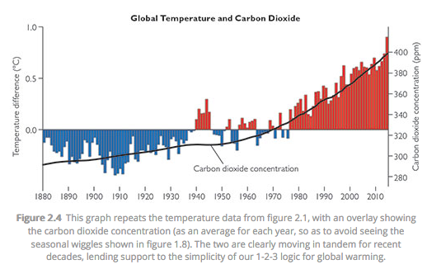

Slide 30
Temperature and CO₂ Concentration
Correlated over Past 800,000 Years!

Slide 31
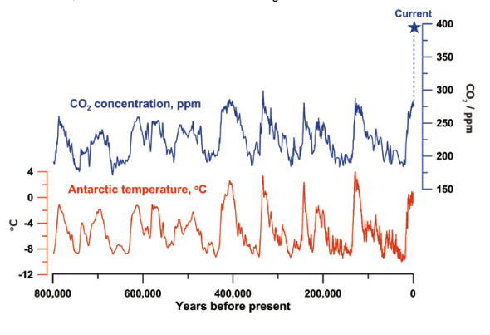
Atmospheric Carbon Dioxide Concentration and Temperature Over Past 800,000 Years
Source: Figure by Jeremy Shakun, data from Lüthi et al., 2008 and Jouzel et al., 2007.

Slide 32
3 Statistical
Studies of
Weather
Impacts

Slide 33
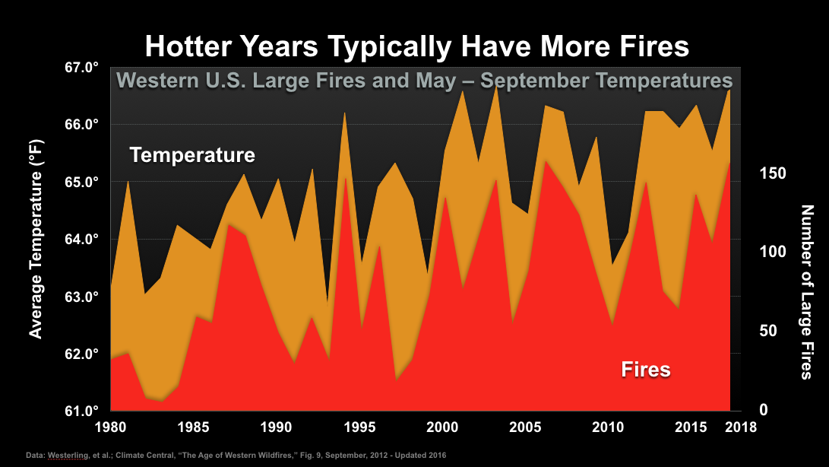

Slide 34
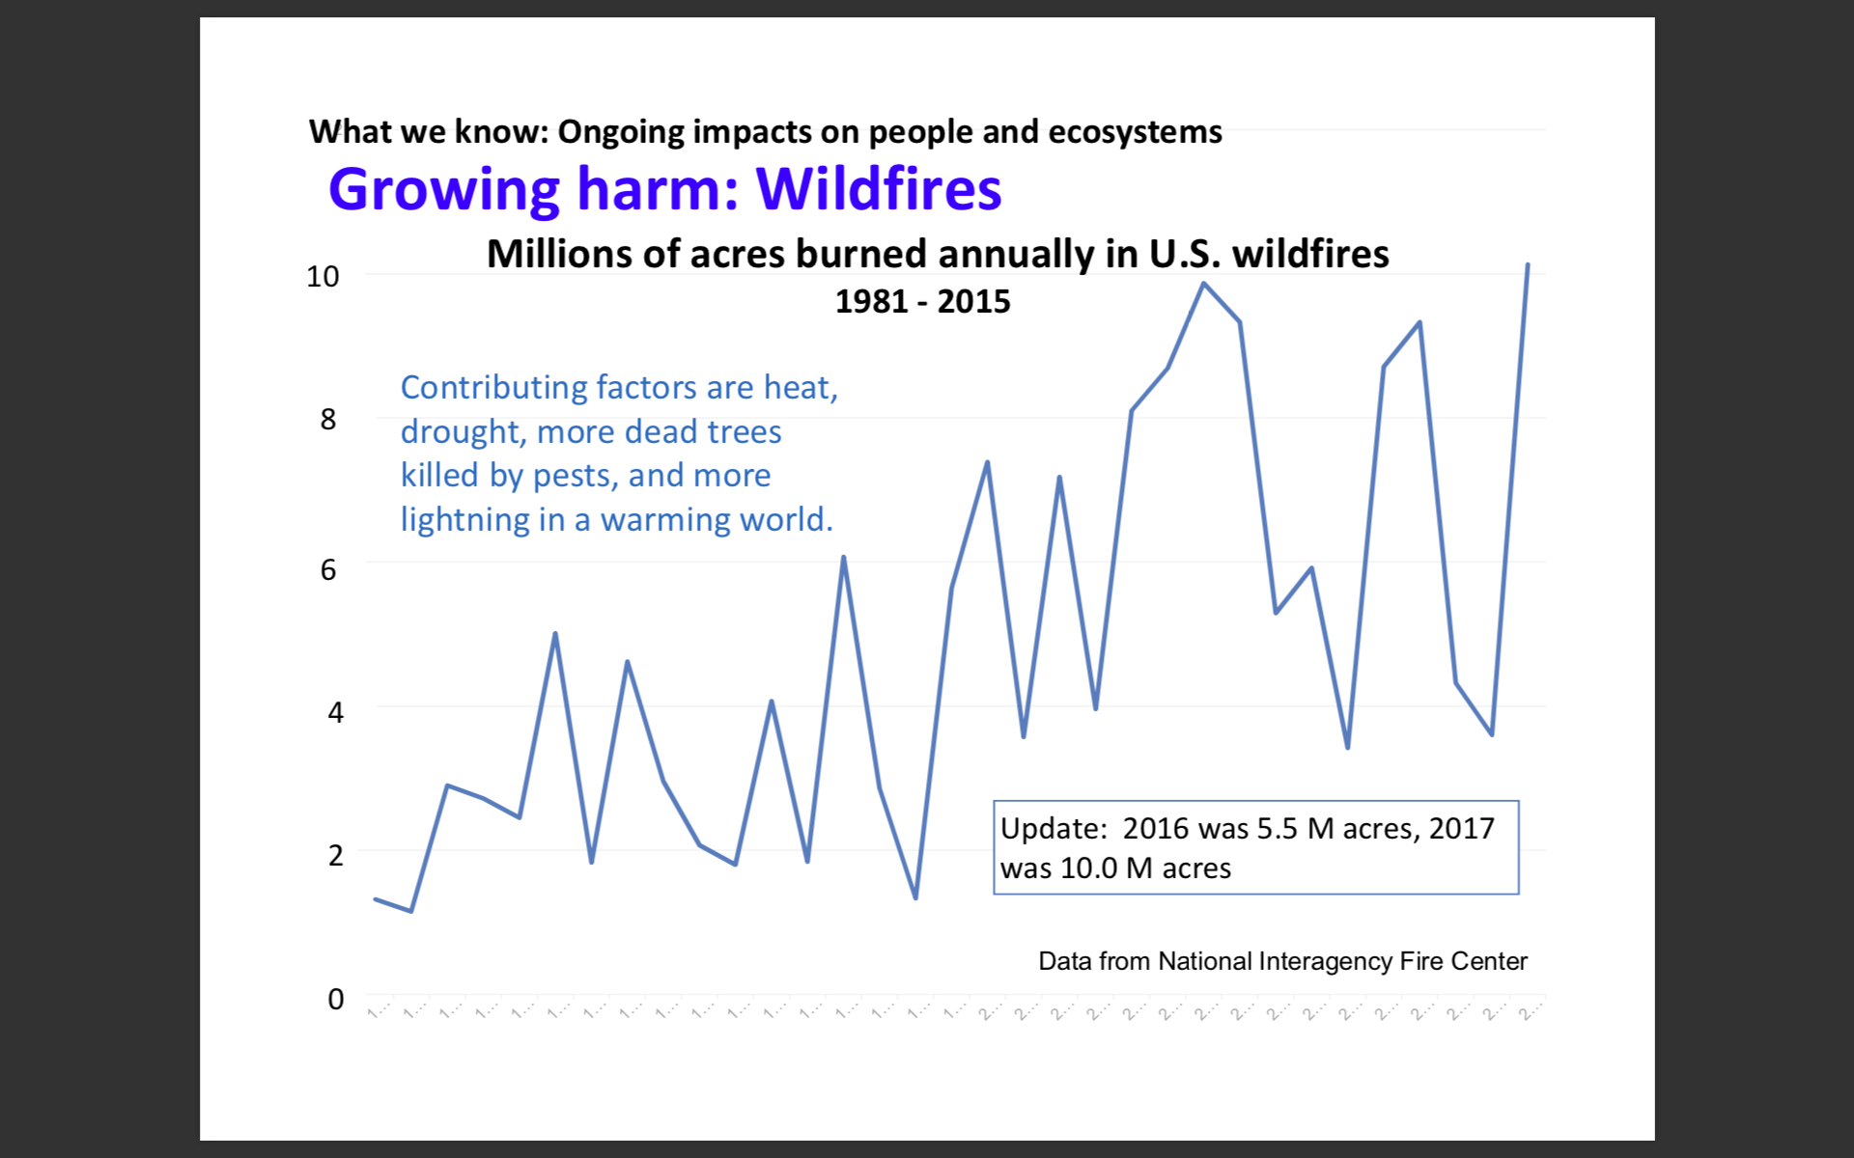

Slide 35
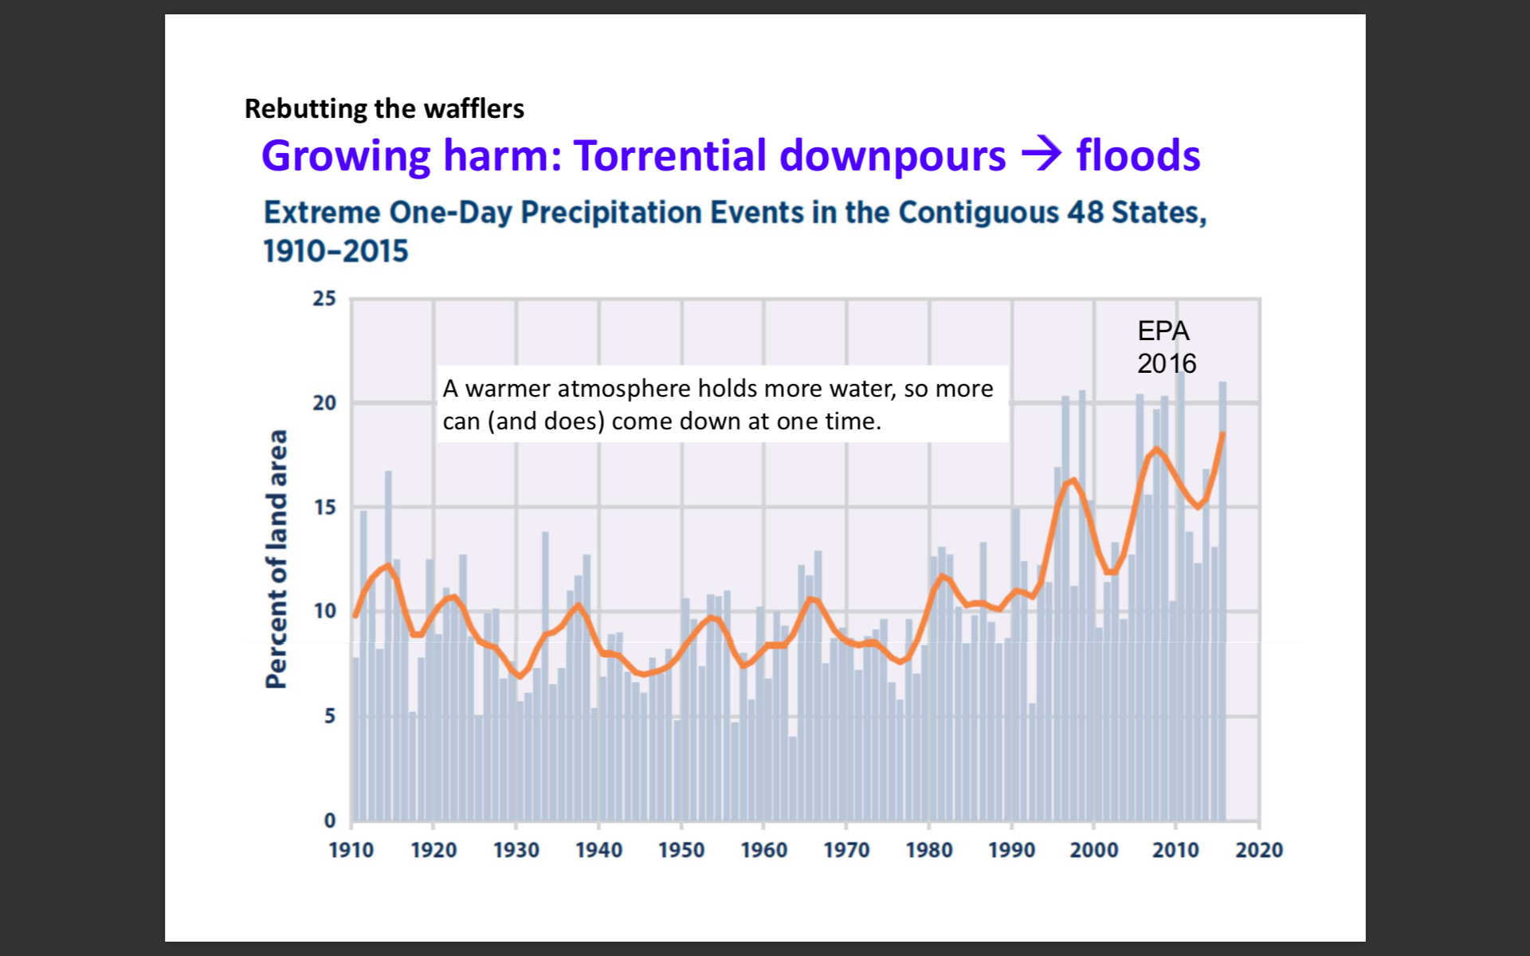

Slide 36
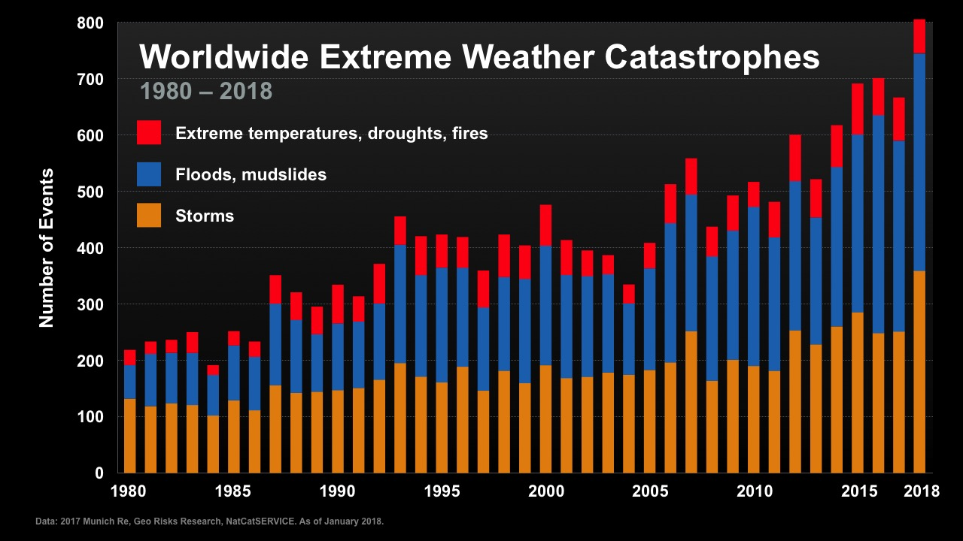

Slide 37
4 Prognosis for
Climate Stabilization

Slide 38
Daunting Challenge:
Changes Affect the Heart of
the Economic System

Slide 39
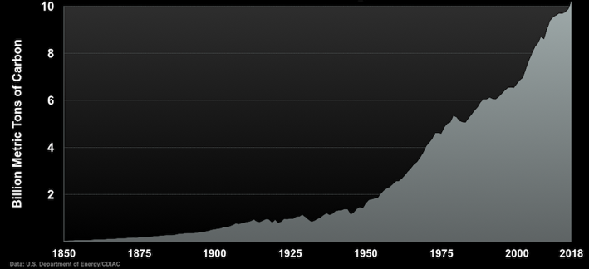
Emissions are increasing, not decreasing

Slide 40
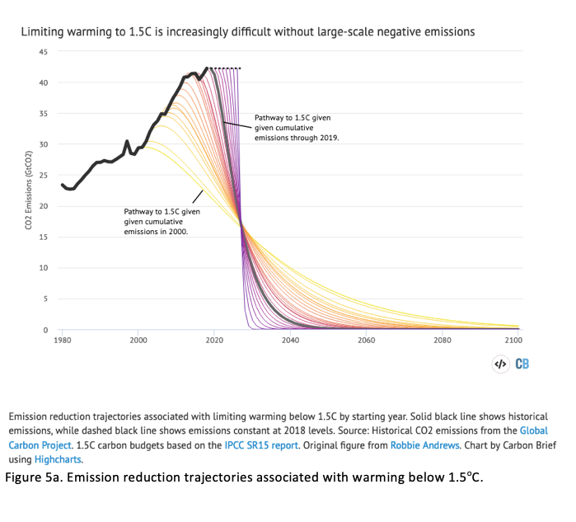
The Climate Threat: the Cost of Delay

Slide 41
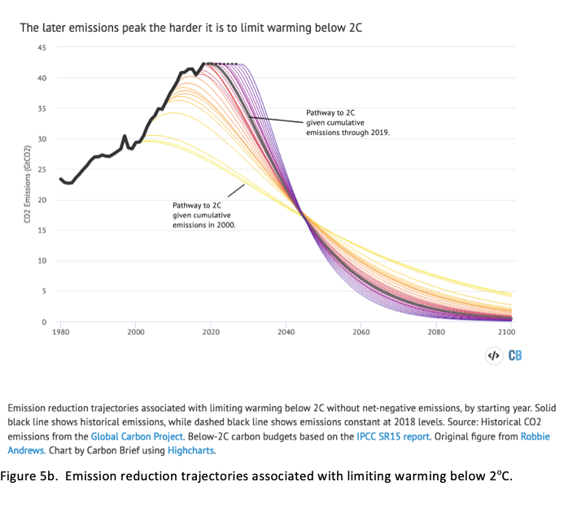
The Climate Threat: the Cost of Delay (2)

Slide 42
Some Reasons for
Optimism

Slide 43
Energy efficiency is advancing

Slide 44
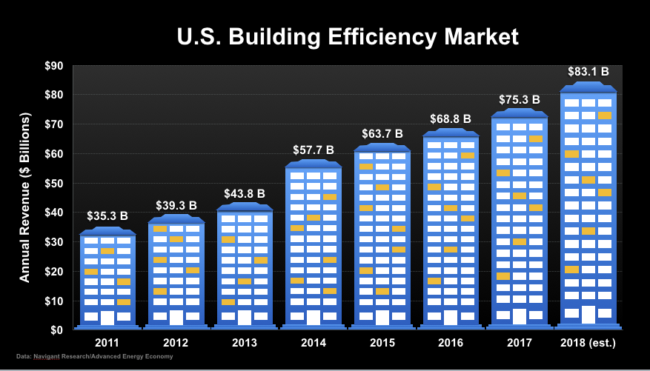

Slide 45
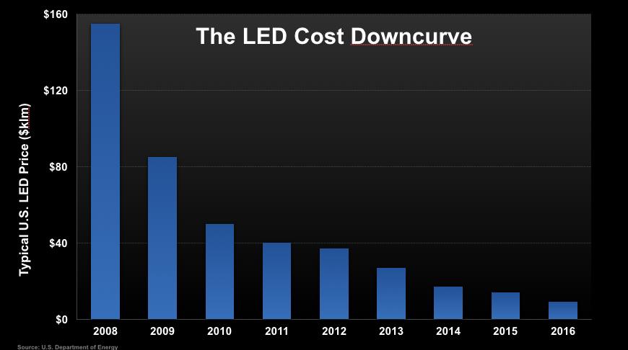

Slide 46
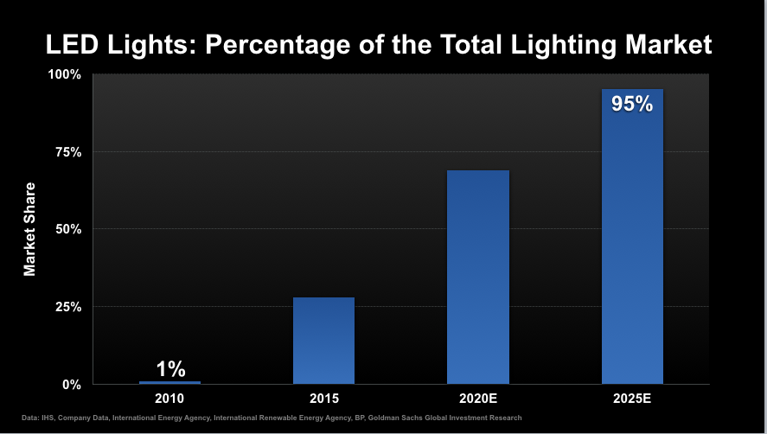

Slide 47
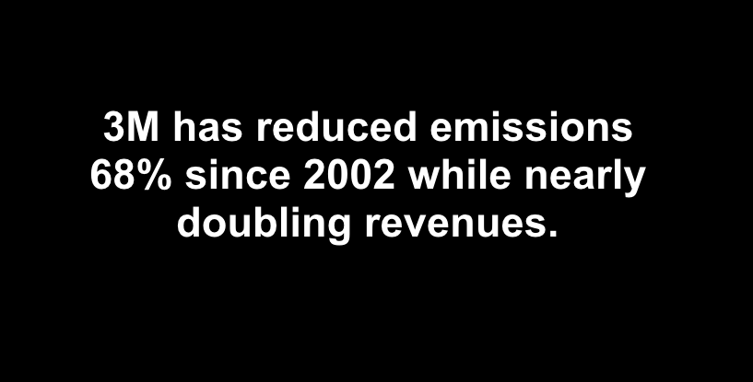
Many other companies
have similar experiences.

Slide 48
Coal is declining

Slide 49
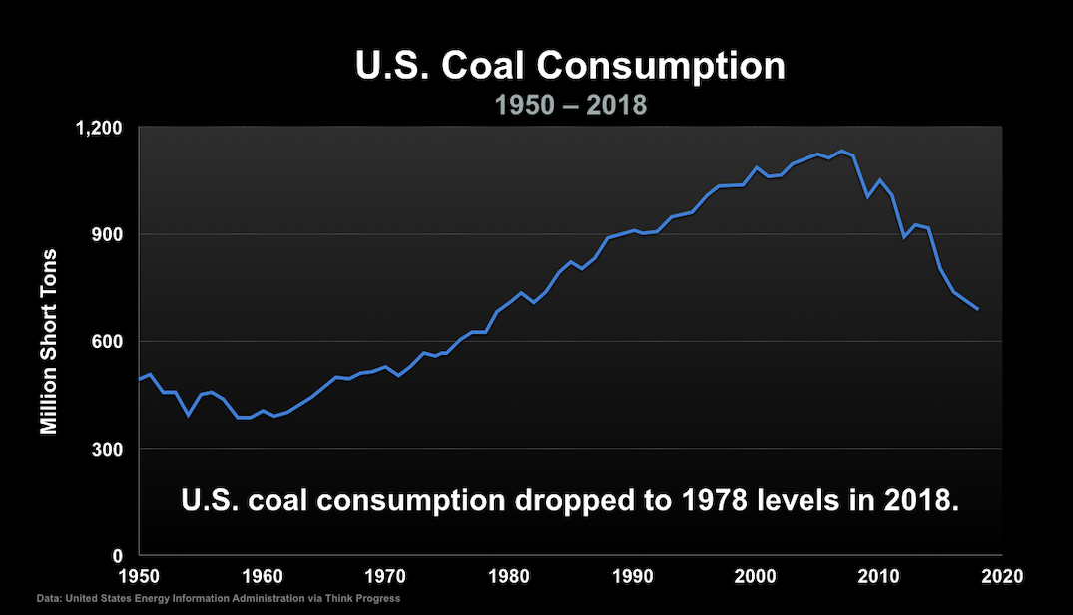

Slide 50
