Slide 1
Climate Crisis:
Solutions and Possibilities
Mark D. Levine
Senior Advisor
Lawrence Berkeley National Laboratory
For Berkeley Society of Friends
September 17, 2021

Slide 2
Topics
Selected News: July and August 2021
Some Basic Information
Statistical Studies of Impacts
Prognosis for Climate Stabilization
  – Daunting Challenge
  – Some Reasons for Optimism
What is to be Done?
  – Individuals
  – U.S. Policies
  – Global Issues: Developing Countries

Slide 3
Renewables are increasing

Slide 4
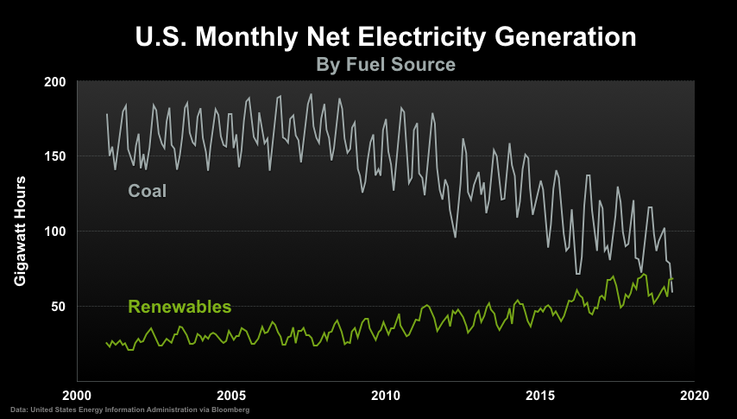

Slide 5
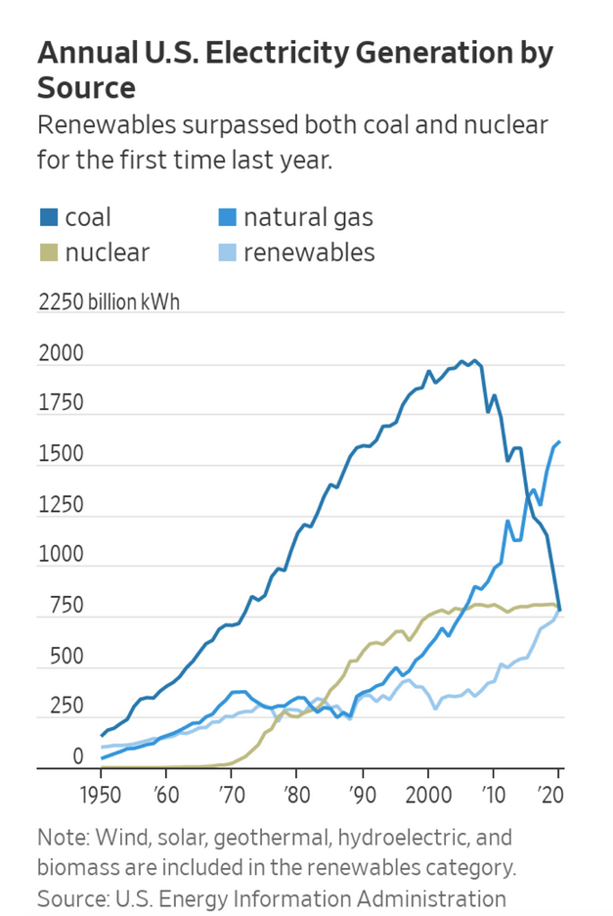

Slide 6
. . . and renewable energy technology is advancing at an amazing pace – lower costs and high market penetration.

Slide 7
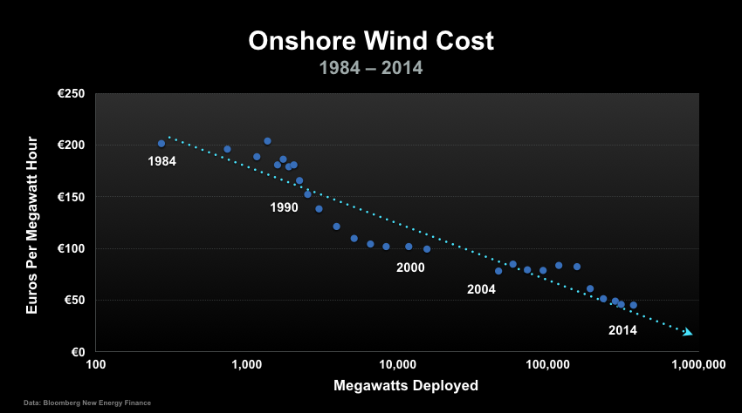

Slide 8
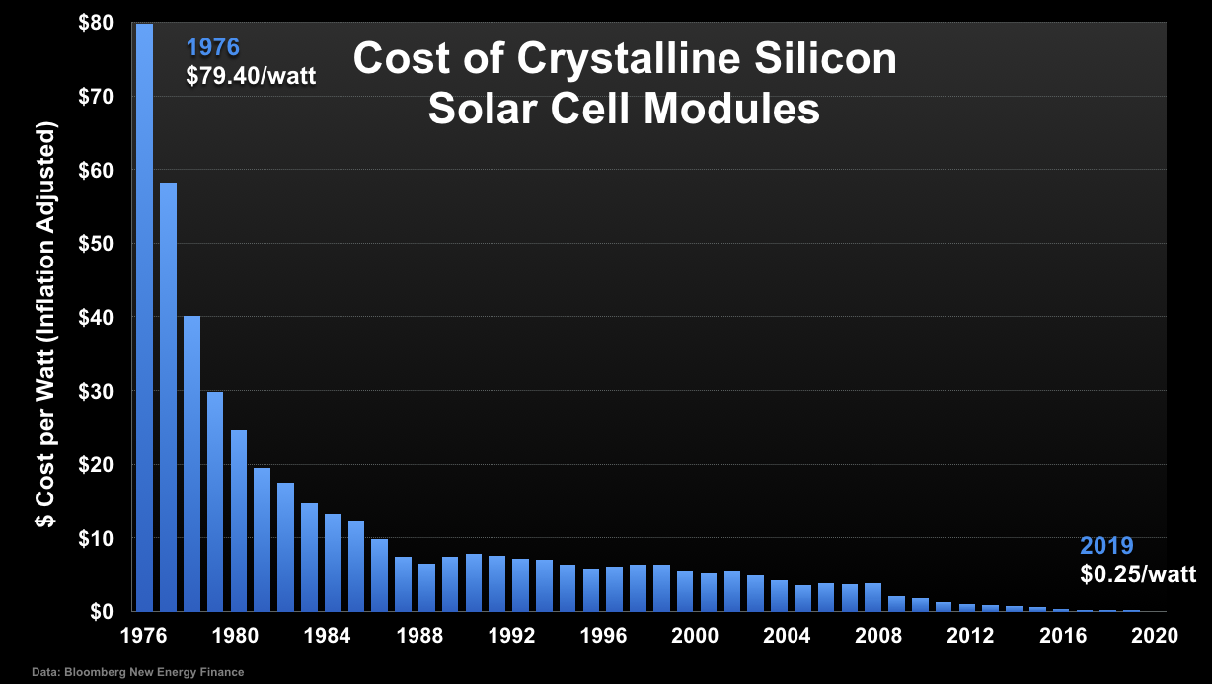

Slide 9
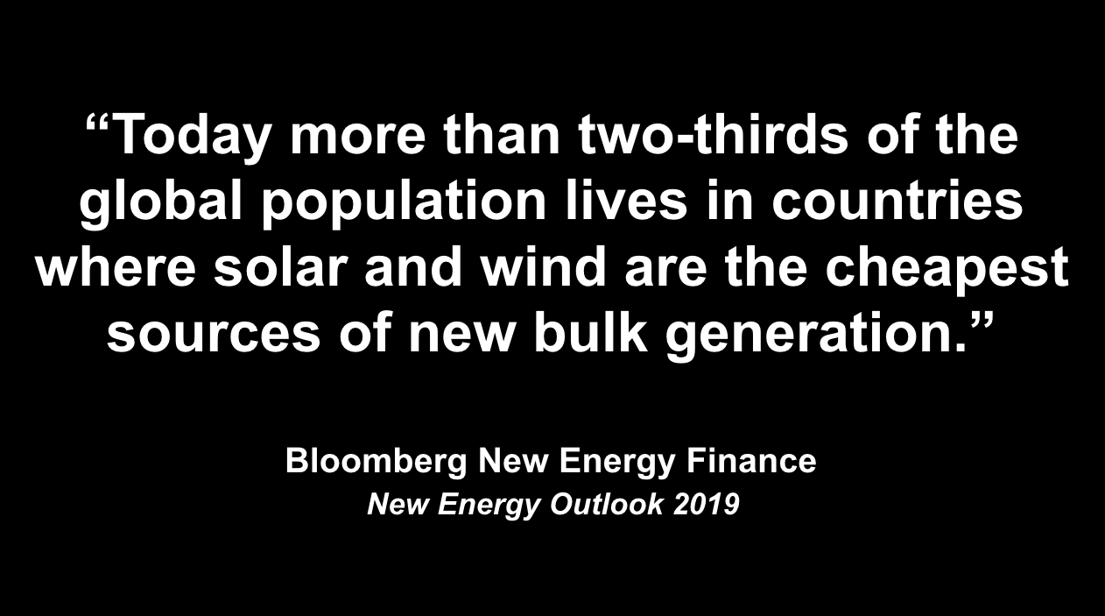

Slide 10
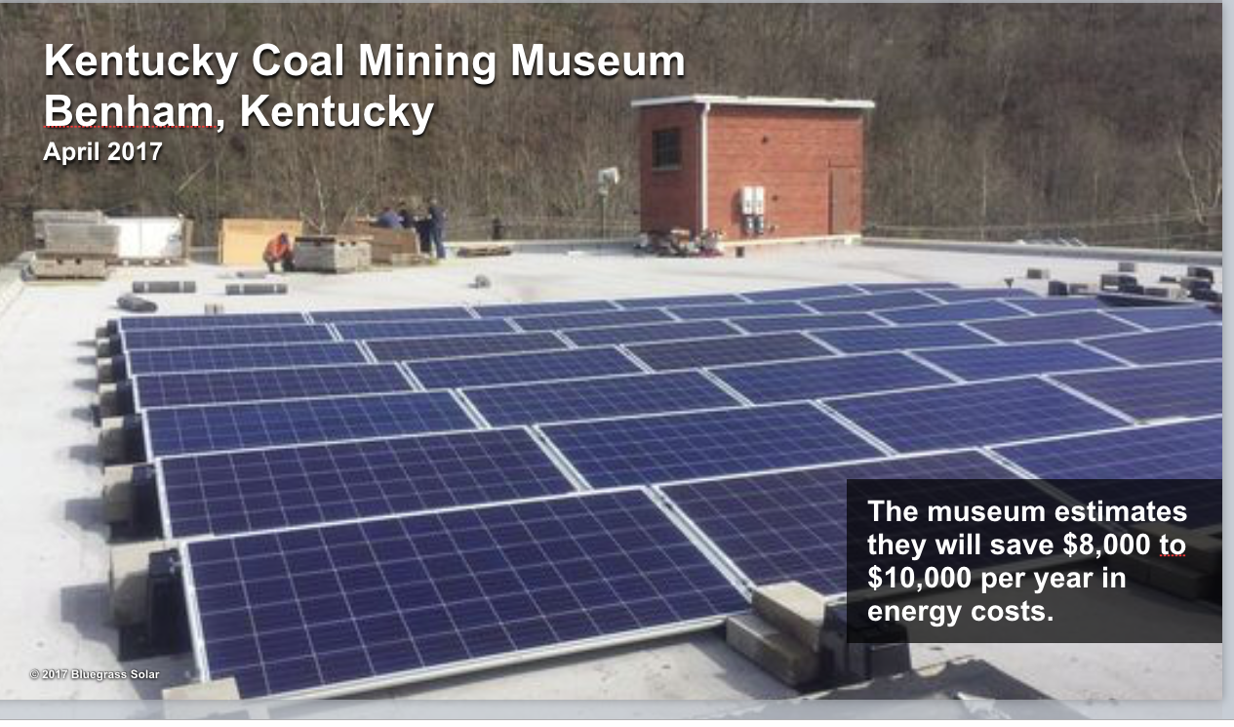

Slide 11
Cars and buses are being electrified.

Slide 12
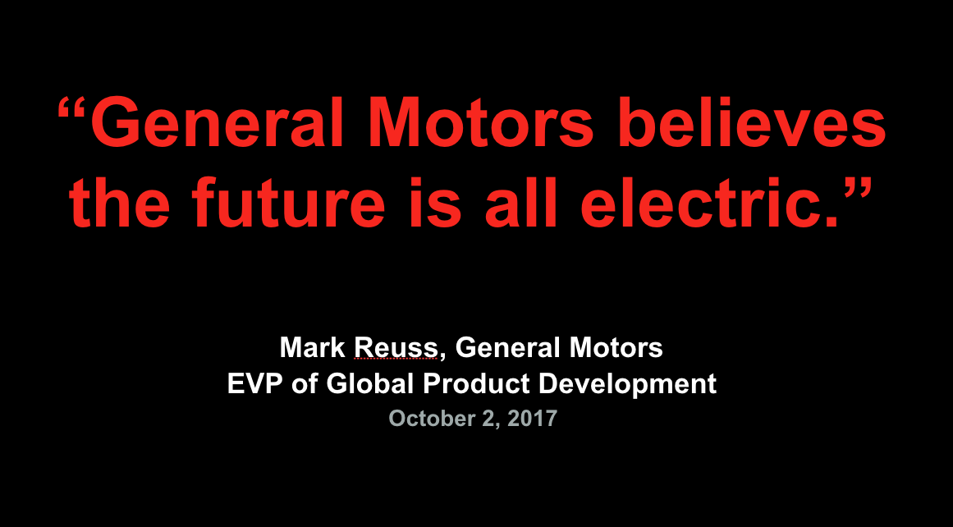

Slide 13
Employment in energy efficiency and renewables dominates
energy workforce

Slide 14
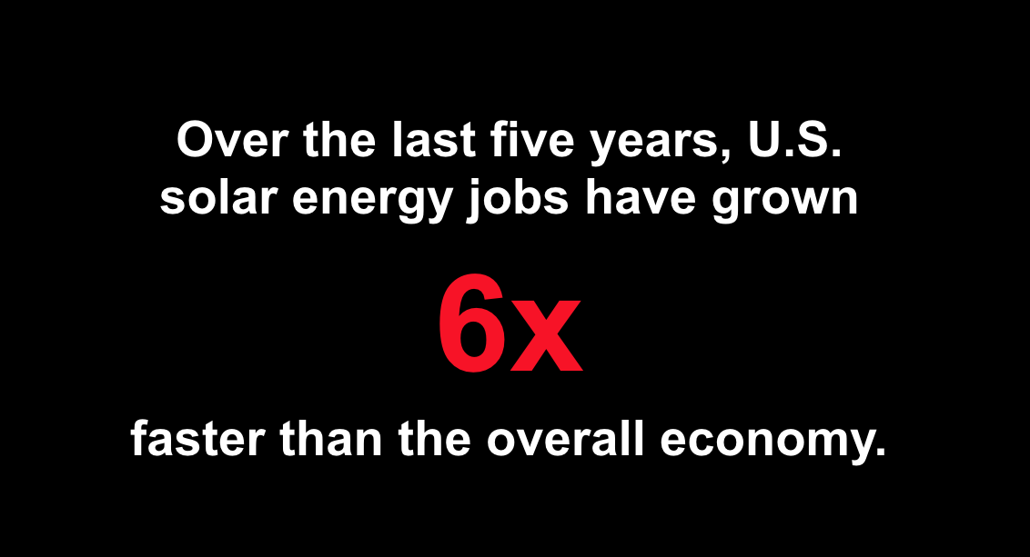

Slide 15
Financial institutions are starting to get the message.

Slide 16
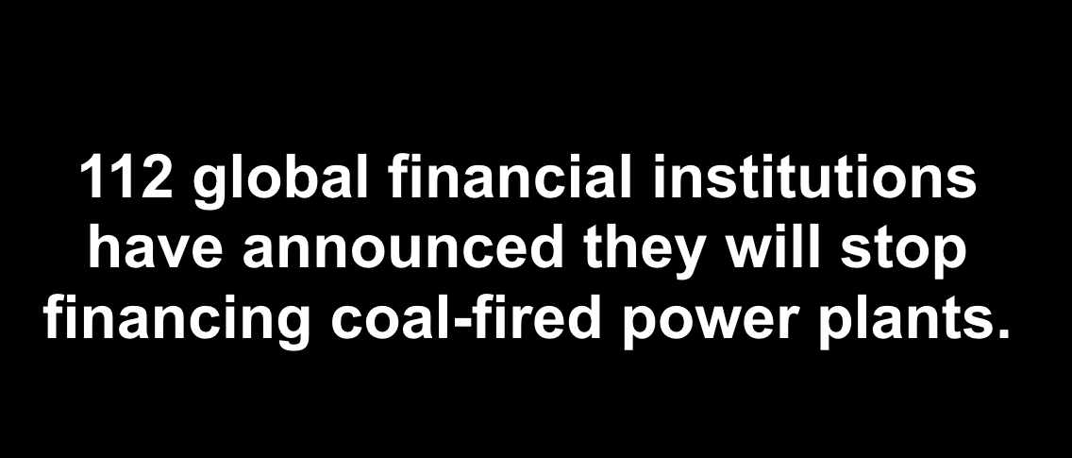
Mitigation
• Individual actions
• Collective actions → policy
• International → assistance to developing countries

Slide 17
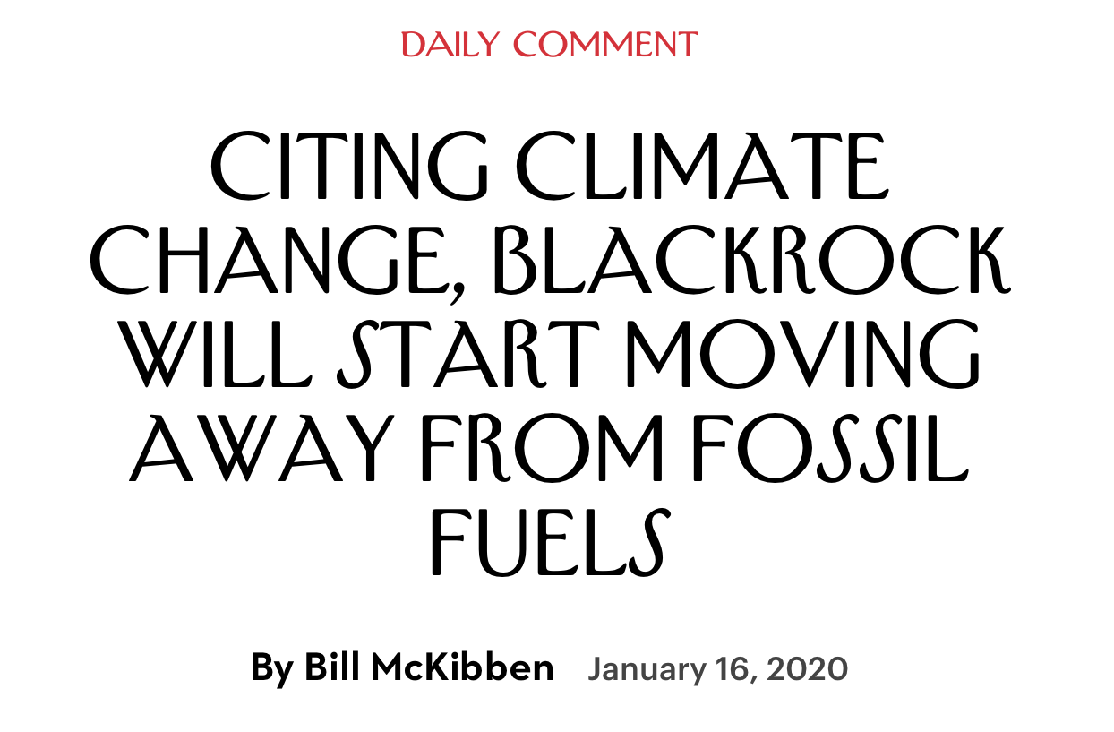

Slide 18
Some states (and most western
European countries) are moving aggressively
And all countries have signed an
international agreement in Paris in 2015 to limit emissions

Slide 19
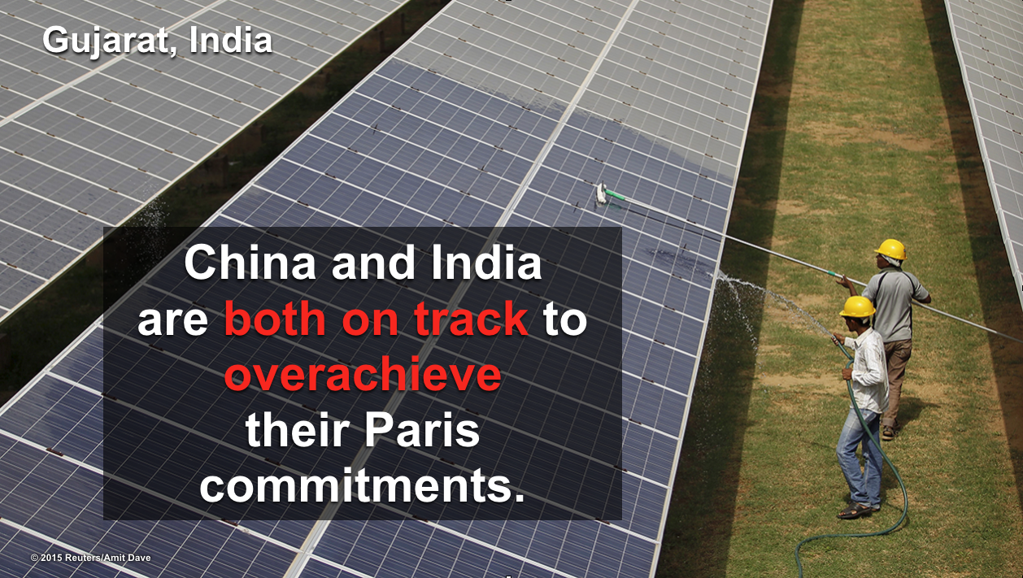
Mitigation
• Individual actions
• Collective actions → policy
• International → assistance to developing countries

Slide 20
5 What is to be Done?

Slide 21
Mitigation
• Individual actions
• Collective actions → policy
• International → assistance to developing countries

Slide 22
Individual Actions

Slide 23
Individual actions
• Home energy efficiency
efficient lighting (LEDs), appliances, heating and cooling
equipment, energy efficiency windows, sealing leaks
• Get an electric car
• Solar system for house
• Shop at stores that are energy efficient and purchase
products whose supply chains are green
• Make your investment portfolio climate friendly
• Work to influence policymakers
• Inform yourself: understand which actions have greatest
impact, understand the importance of climate change,
and talk about this to neighbors and friends

Slide 24
Policies

Slide 25
Policies (efficiency and electrification)
  Standards for all sectors: buildings, appliances, vehicles, industry
  Retrofit programs for buildings and industry
  Utility programs (renewable portfolio standards; DSM programs, electrification*)
  Electrification: vehicles, buildings, industry
  Green Infrastructure: large construction projects
  Cross-cutting
  Carbon pricing (carbon fee and dividend)
  Finance
  * Requires assurance that electricity will be low or no emitting

Slide 26
GWH Impacts from Programs Begun Prior to 2001
40,000
~ 14% of Annual Use in California in 2001
35,000
30,000
25,000
GWH
20,000
15,000
Utility Programs
10,000
Building Standards
5,000
Appliance Standards
0
1975
1976
1977
1978
1979
1980
1981
1982
1983
1984
1985
1986
1987
1988
1989
1990
1991
1992
1993
1994
1995
1996
1997
1998
1999
2000
Source: Mike Messenger, CEC Staff, April 2003
Notes:
Estimate some of the casues of this 2%/year gain. Each year, the cost of conservation programs, public interest R&D, and standards adds ~1% to electric bills, but cuts 1/2% off the bill. So an investment of $1 in say 1990 saves $.50 per year for 10 to 20 years.
Although not depicted on this slide, other policies also have led to electricity savings in California. For example, California standards allow electric water heating in homes only when it is cost effective: which is seldom the case. This has resulted in only limited electricity use for this purpose in California. Per Capita use is just 200 kWh in California for electric hot water heating while in Florida the use is about 1,200 kWh per person.

Slide 27
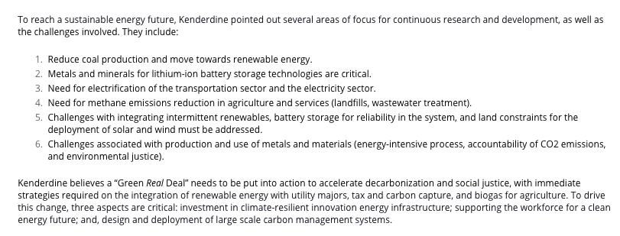

Slide 28
Global Issues

Slide 29
The Crucial Role of
Developing Countries

Slide 30
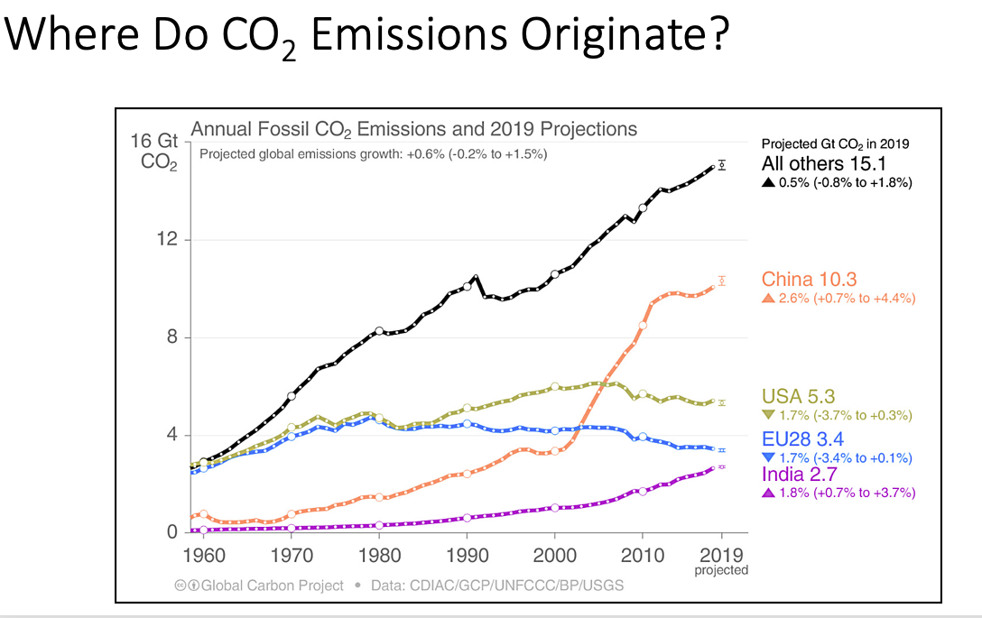

Slide 31
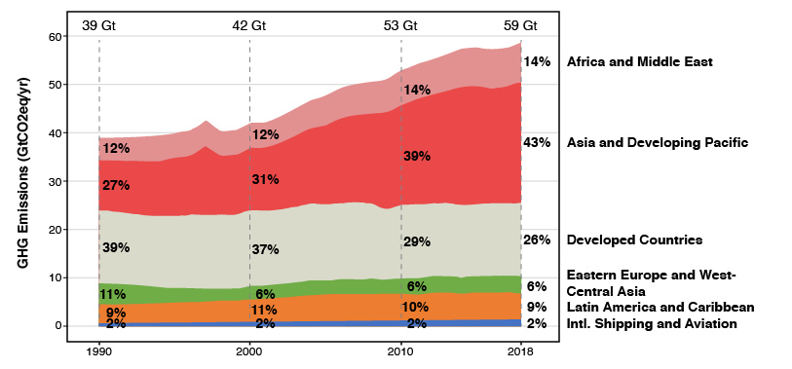
Trends in GHG Emissions by Region of the World

Slide 32
Way back in December 2009 at the COP in Copenhagen, the developed countries promised an incremental $100B/year to assist the developing countries address climate change. Funding since then has been less than 10% of what was promised.

Slide 33
Not only are funds required, but there is a need for much more:

Slide 34
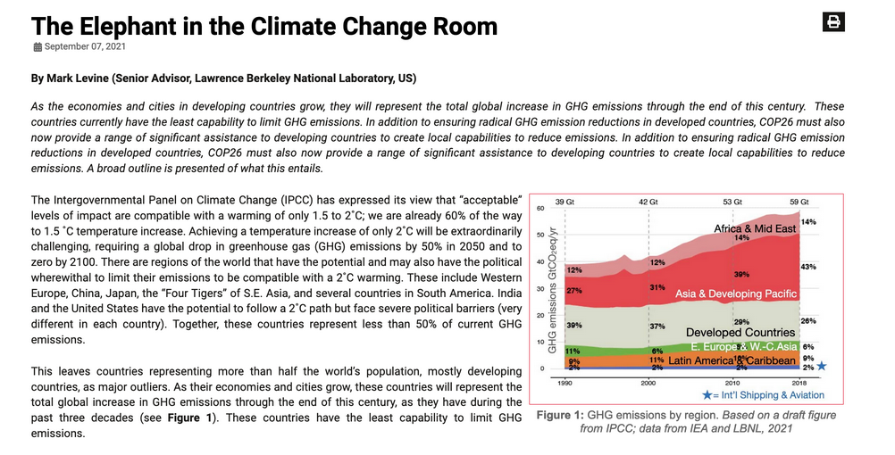

Slide 35
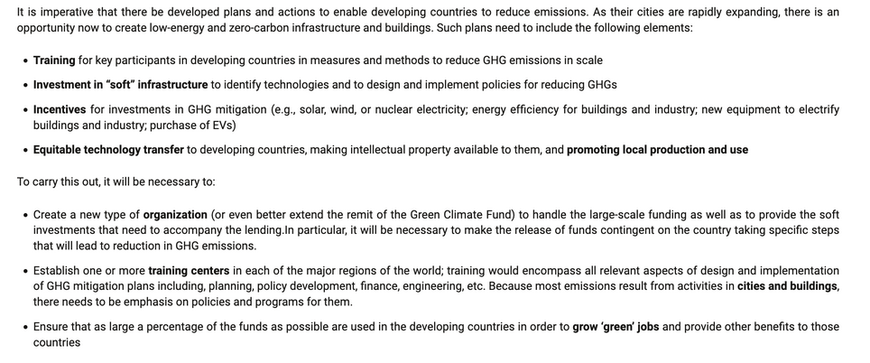

Slide 36
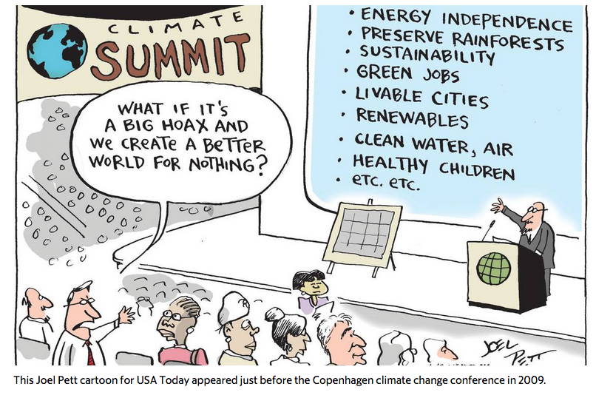

Slide 37
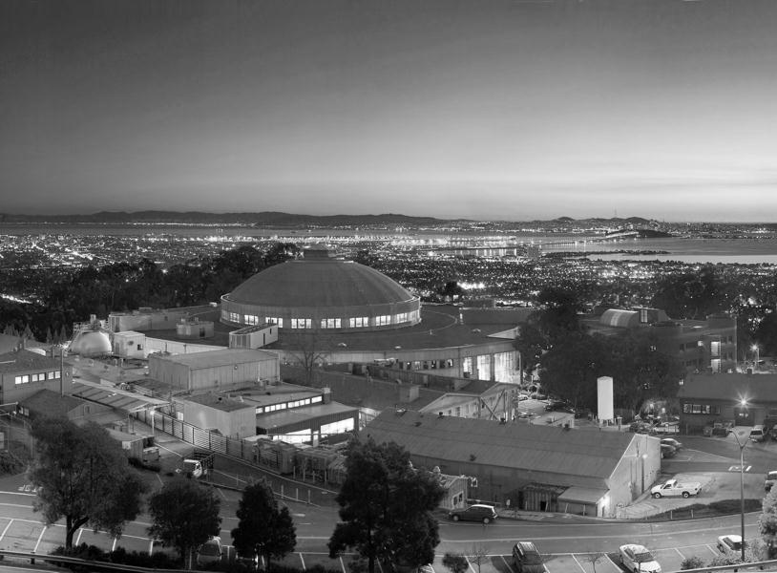
Thank you
mdlevine@lbl.gov

Slide 38
Why does ∆T of 1˚ C – temperature rise since pre-industry – matter so much?

Slide 43
